Slide 1

December 15, 2016
Loyola Marymount University – CMSI 401
Prof. BJ Johnson
Nicole Anguiano, Chris Dellomes, Chris Franco, Eko Khizanishvili, Lauren Konchan, Josh Kuroda, Mary Kate Reid, Ed Seim, Mondo Yamaguchi

Slide 2
Description
A client-side, browser-based interface (frontend)
Web-pages to allow the user to easily input, request, and view information stored in the database
A cloud-hosted server (backend)
A database that will store, send, and query data
Backend and database configured to optimize concurrent access
HIPAA compliance

Slide 3
Goals
Allow staff to enter information relevant to incoming youth
Store the data in a secure, HIPAA compliant database
Present and allow editing of the data
Record drop in information for each day
Make appointments between youth and case managers
Sign youth up for available activities
Generate custom reports and charts

Slide 4
Justification – Why we are Interested
Significantly impact the organization’s productivity
Help generate monetary value and resources
Utilize a collection of skills and knowledge acquired
Construct a product with real world applications

Slide 5
Justification – Good use of our Abilities
Communication & Requirements Gathering
Planning & System Design
Teamwork & Version Control
Design, Implementation, & Integration
Front End, Back End, Database

Slide 6
Justification - Curriculum
Interaction Design
Programming Languages
Data Structures & Algorithms
Statistics
Databases

Slide 7
Operation
3 Roles and their use cases:
Front Desk Manager Actions
Add New Client
Add New Drop-In
New Activities
Case Manager Actions
Case Notes
Guest Actions
Outreachers, Interns, Workshop Supervisor

Slide 8
UML Use Case Diagrams

Slide 9
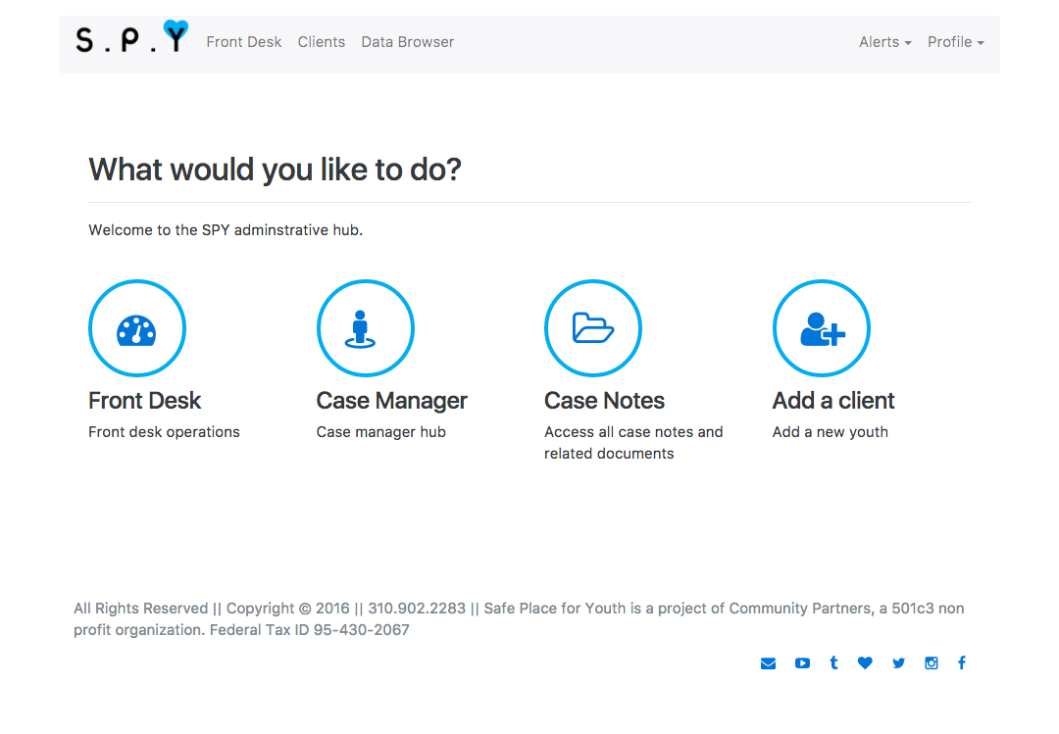
User Interface

Slide 10
Architecture
Add Client Profile Modal
Create New Drop-in Session Modal
Add New Case Note Modal
Edit Drop-In Session Modal
Create New Activity Modal
Enrollment Component
View Client Component
Activities Table Component
Client Profile Table Component
Uses
Frontdesk Webpage
Casemanager Webpage
Data Browser Webpage
SPY Administrator Homepage
Login Dialog
View Routes API
Client-Side Server NodeJS
API Routes Module
…

Slide 11
Architecture (continued)
…
API Server Response Module
API Callback Module
API Service Module
API Query Module
Datbase Server PostgreSQL
Tables
API Queries Library Module

Slide 12
UML State Diagrams – Add Client
Mouse and KeyBoard actions
Mouse Clicked
(Add Client)
Start
Waiting for an Action(Click)
(Modal or Webpage present) of all the data fields to be entered
Waiting for Input Fields to be filled in
Submit button clicked
Redirected to frontdesk/homepage
Information stored into DataBase

Slide 13
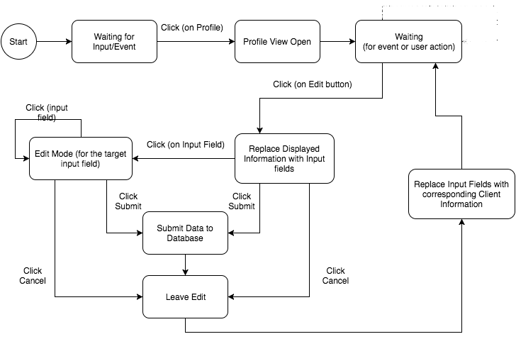
UML State Diagrams – Edit Client

Slide 14
Challenges
Hosting problem
HIPAA Compliance
SPFY Budget
Team organization
Client communication
ReactJS
Morale (How did we solve this problem?)
Notes:
We still haven’t solved the hosting problem
Microsoft access is still making us behind because we spent so much time on it
HIPAA Compliance is being worked on, though it still needs more work
We have made progress on our team organization
We have been meeting with new people in SPY, so we’ve had to learn to communicate with those new people
Class requirements are always a labourous process to create

Slide 15

Where are we now?

Slide 16
Thank You!
Questions, Comments, or Concerns

